Slide 1

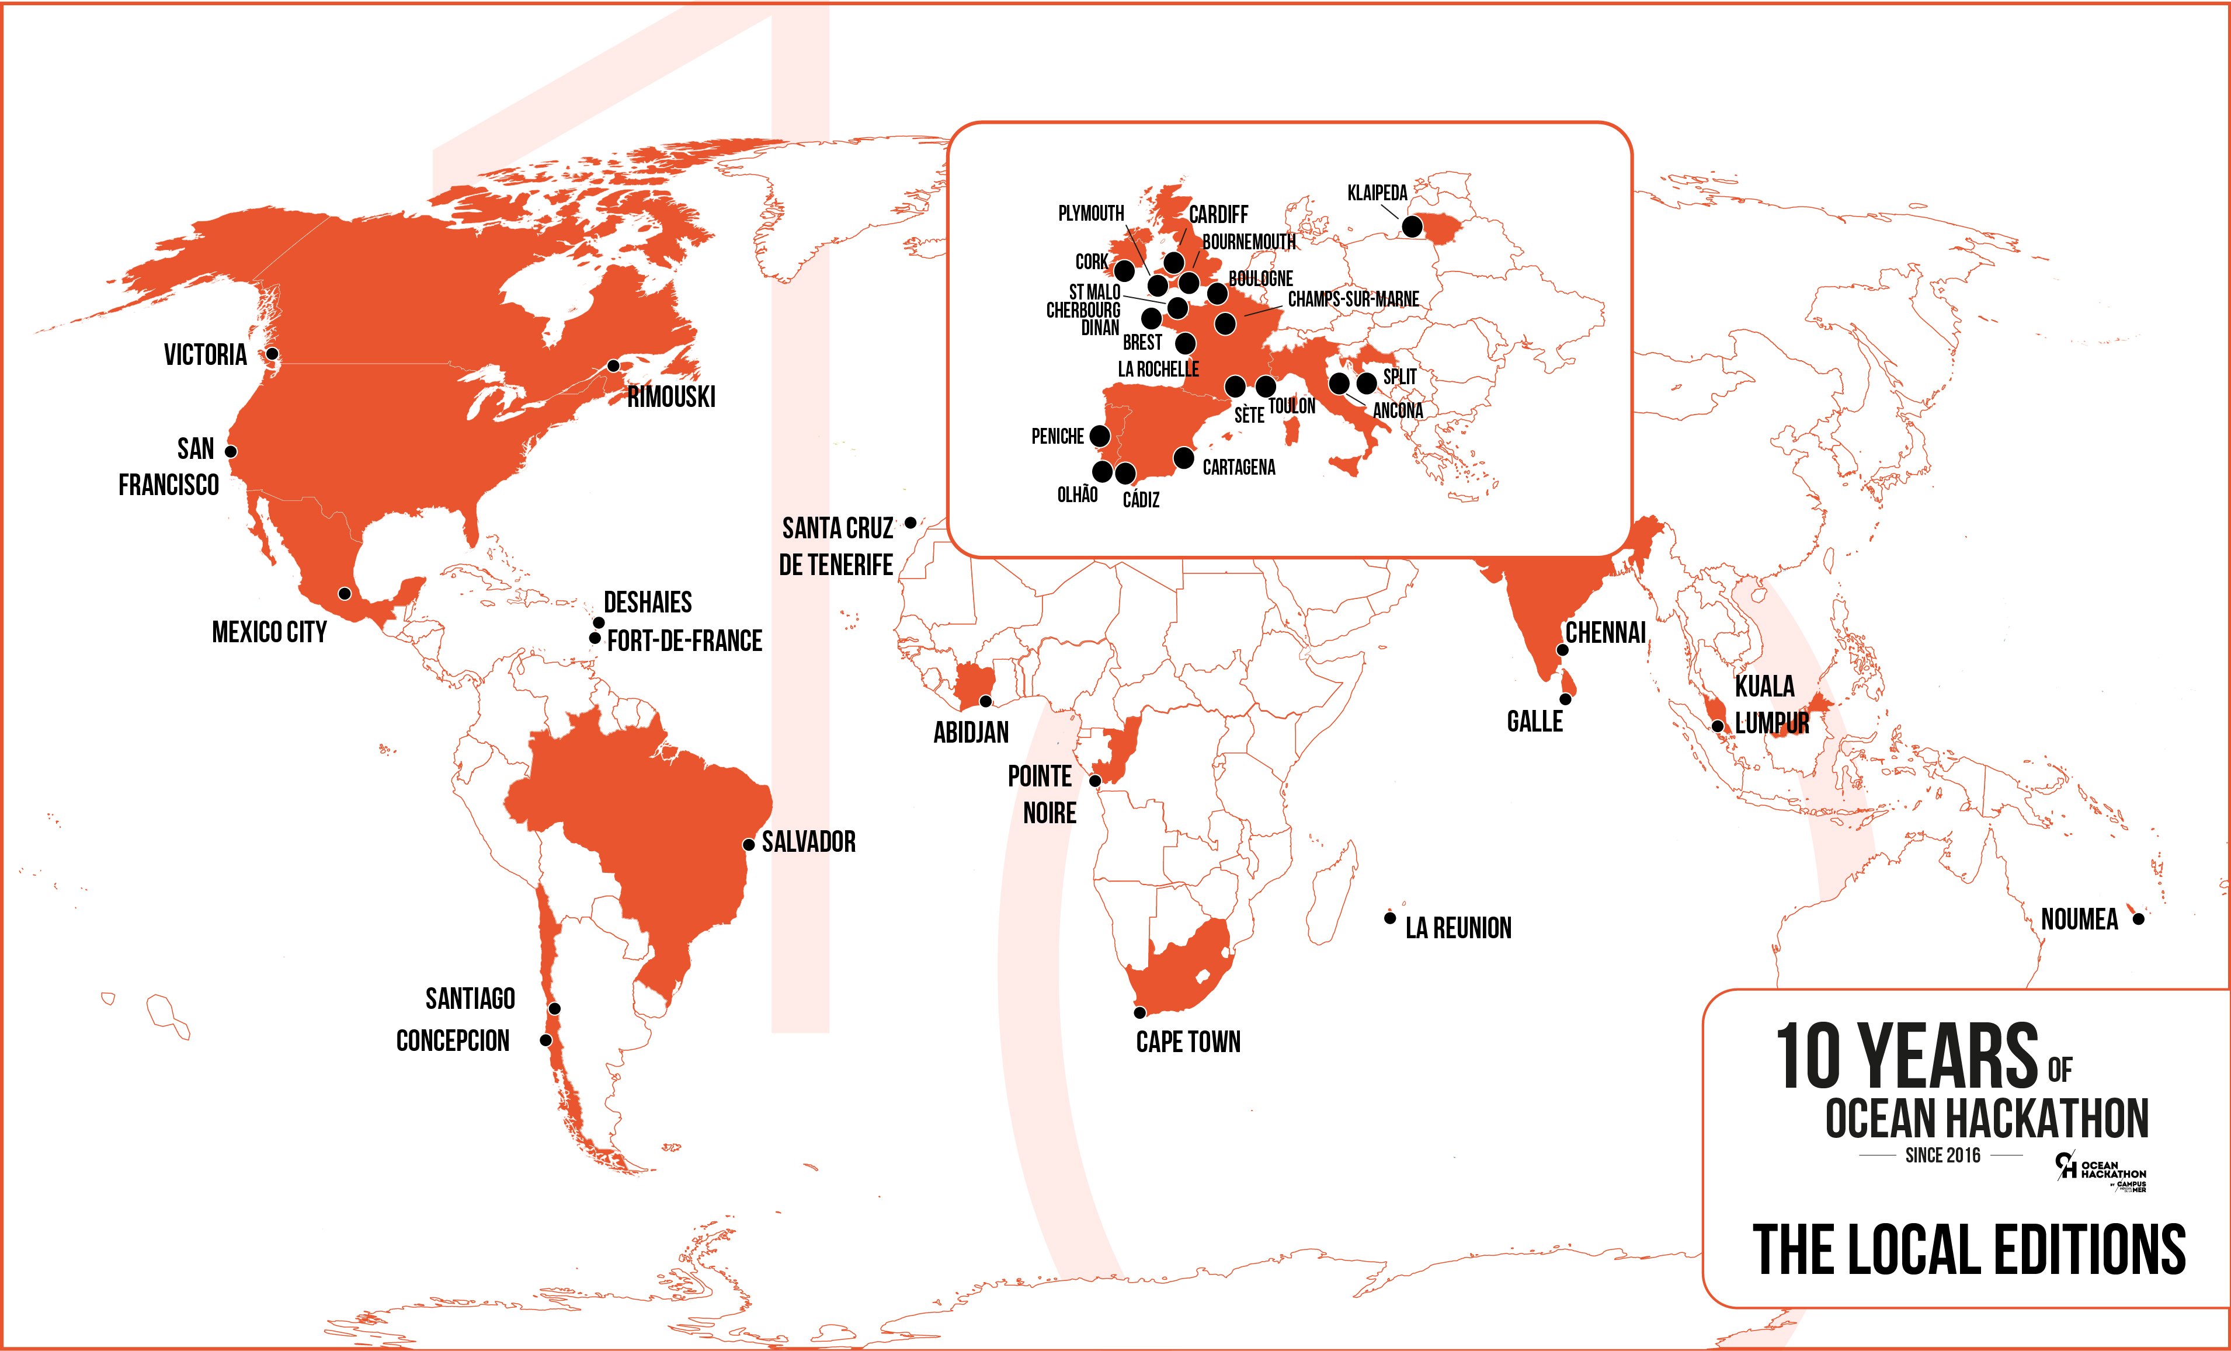

Slide 2
Ocean hackathon® spirit

Slide 3

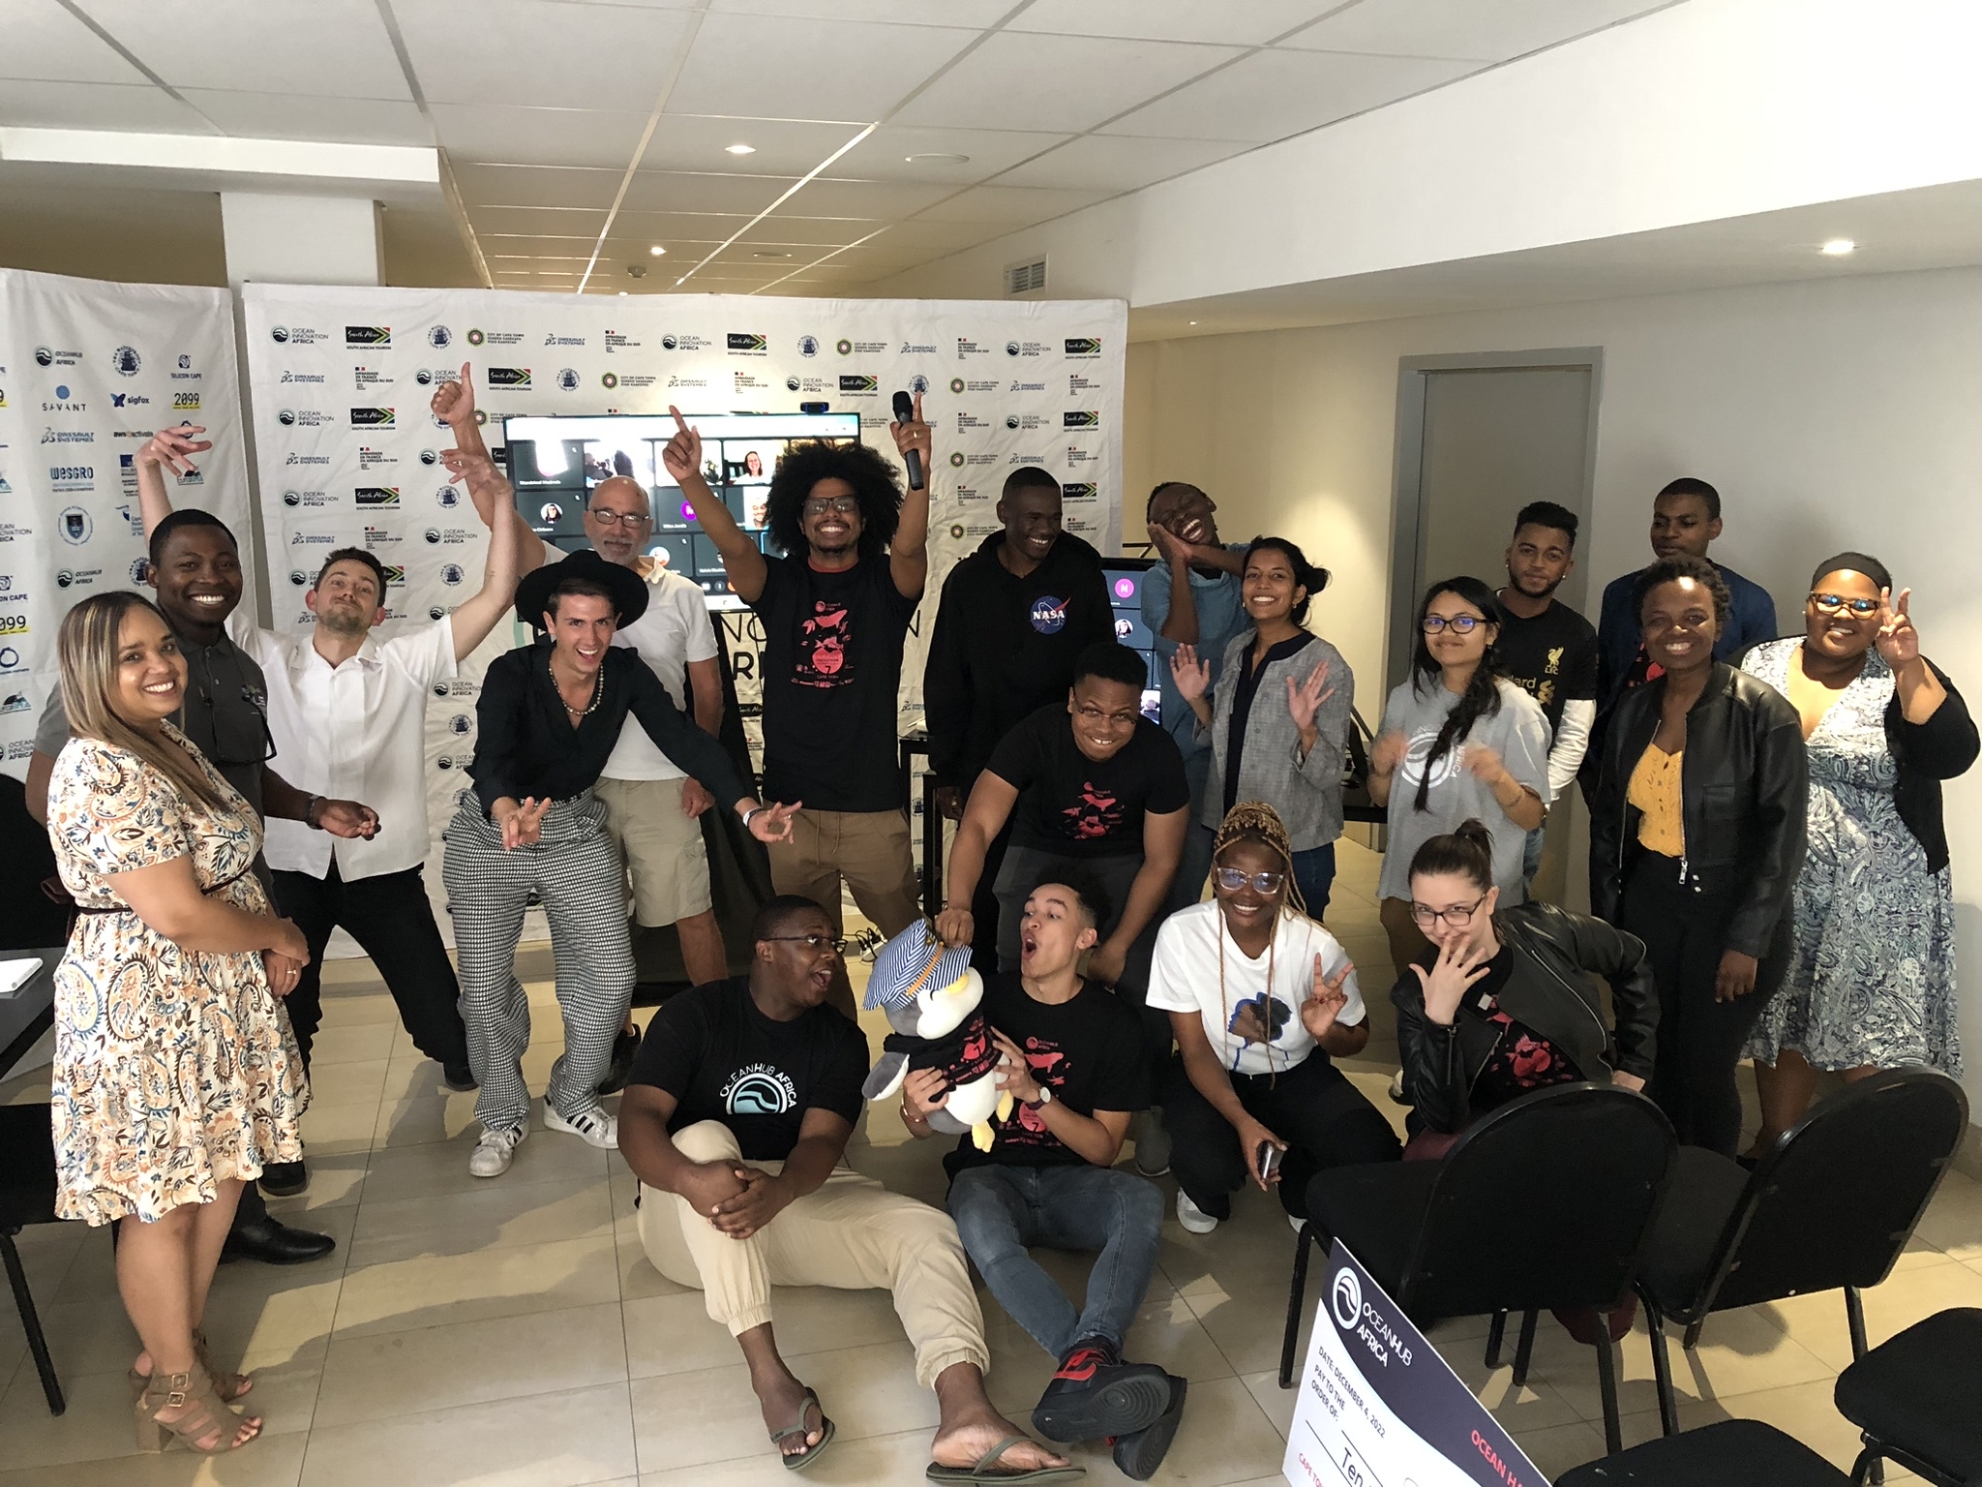




What is Ocean Hackathon®?
An event created in 2016 by Campus Mondial de la Mer
Gone global since 2019
Building a community
of marine science and technology stakeholders (academic, scientific, economic and institutional)
Fostering innovation
to provide answers to marine-related issues
Enhancing new uses of public data
collected by research organisations
Notes:
The coordination team of Ocean Hackathon is employed by Technopole Brest iroise a business support organisation, located in Brittany in France.
Ocean Hackathon aims to : …

Slide 4
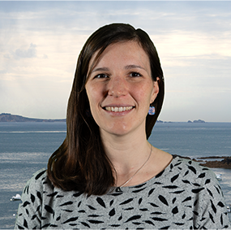
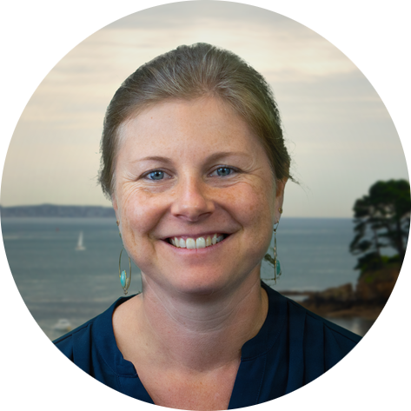
Who is organizing
Ocean Hackathon®?
International coordination
&
Organisation of the event in your city
Your local Adviser
Laura PERRIN
General Coordination
+ Data
Juliette RIMETZ
Promotion
And more: Erwan Chérel, Emmanuelle Dilasser, Alexis Donnart, Véronique Leloup
Notes:
Laura Perrin, project officer at technopole Brest Iroise in the Campus mondial de la mer team, is the general coordinator of the event.
Juliette is the promotion coordinator.
In each cities there is 2-3 advisers that did actually organise the local event supported by the coordination team.

Slide 5
38 hosting Locations since 2019
Notes:
10 years of Ocean Hackathon® since 2016

Slide 6
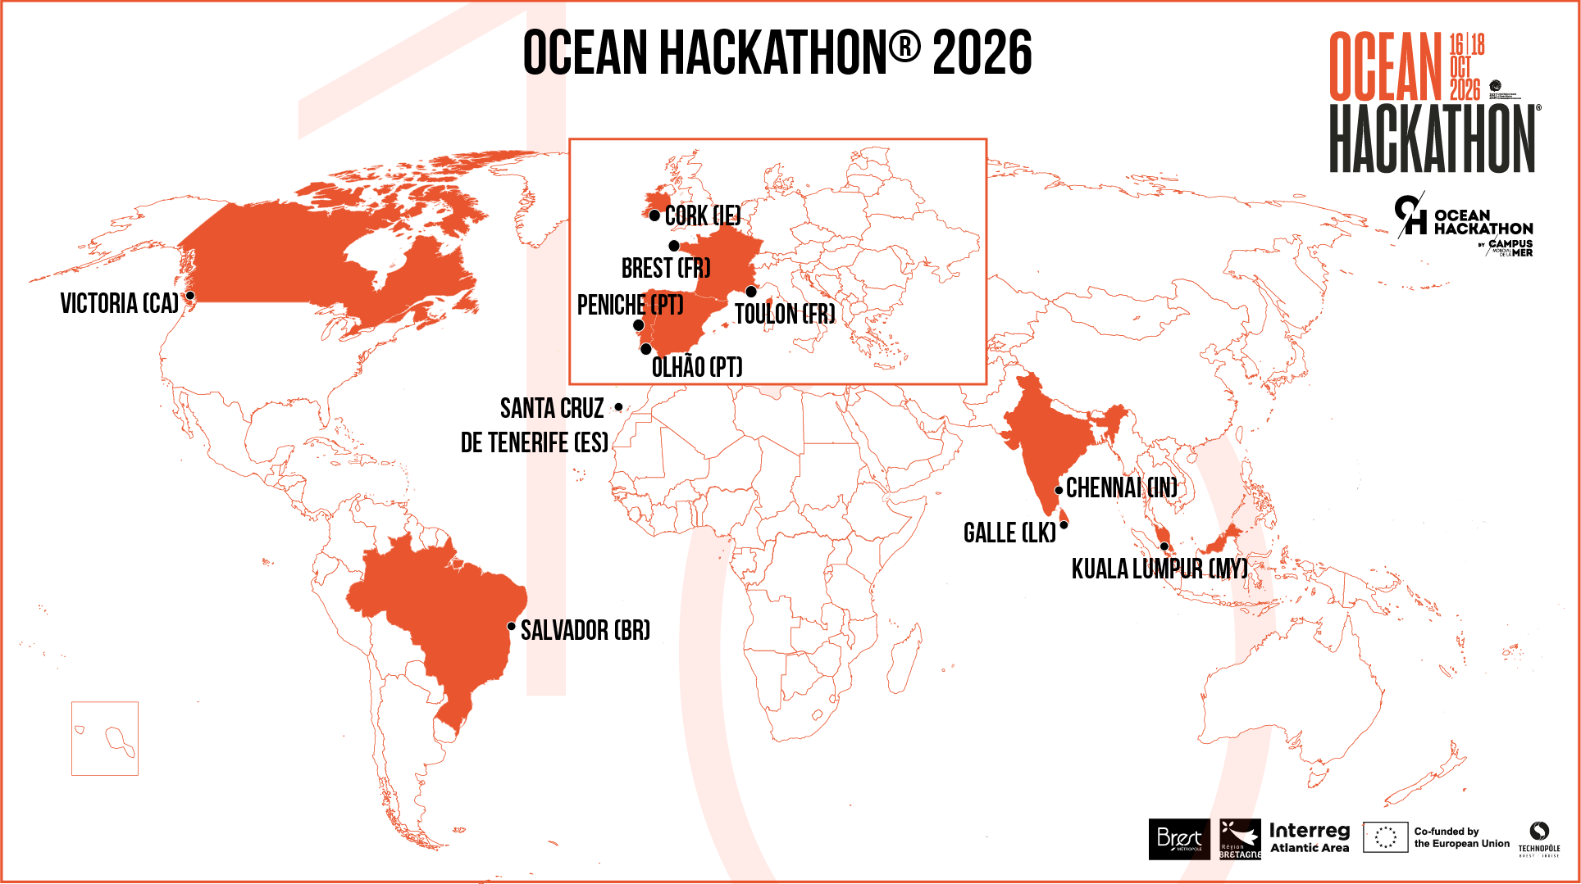
11 hosting cities
9 countries
58 challenges
Notes:
11 different cities from 9 different countries
Call for challenges are open for each local edition

Slide 7

Notes:
Victoria in Canada

Slide 8

Notes:
Salvador in Brasil

Slide 9

Notes:
Chennai in India

Slide 10

Notes:
Galle in Sri Lanka

Slide 11

Notes:
Kuala Lumpur in Malaysia

Slide 12

Notes:
Santa Cruz de tenerife in Spain

Slide 13

Notes:
Olhao in Portugal

Slide 14

Notes:
Peniche in Portugal

Slide 15

Notes:
Cork in Ireland

Slide 16

Notes:
Toulon in France

Slide 17

Notes:
Brest in France by the Campus mondial de la mer’s team

Slide 18




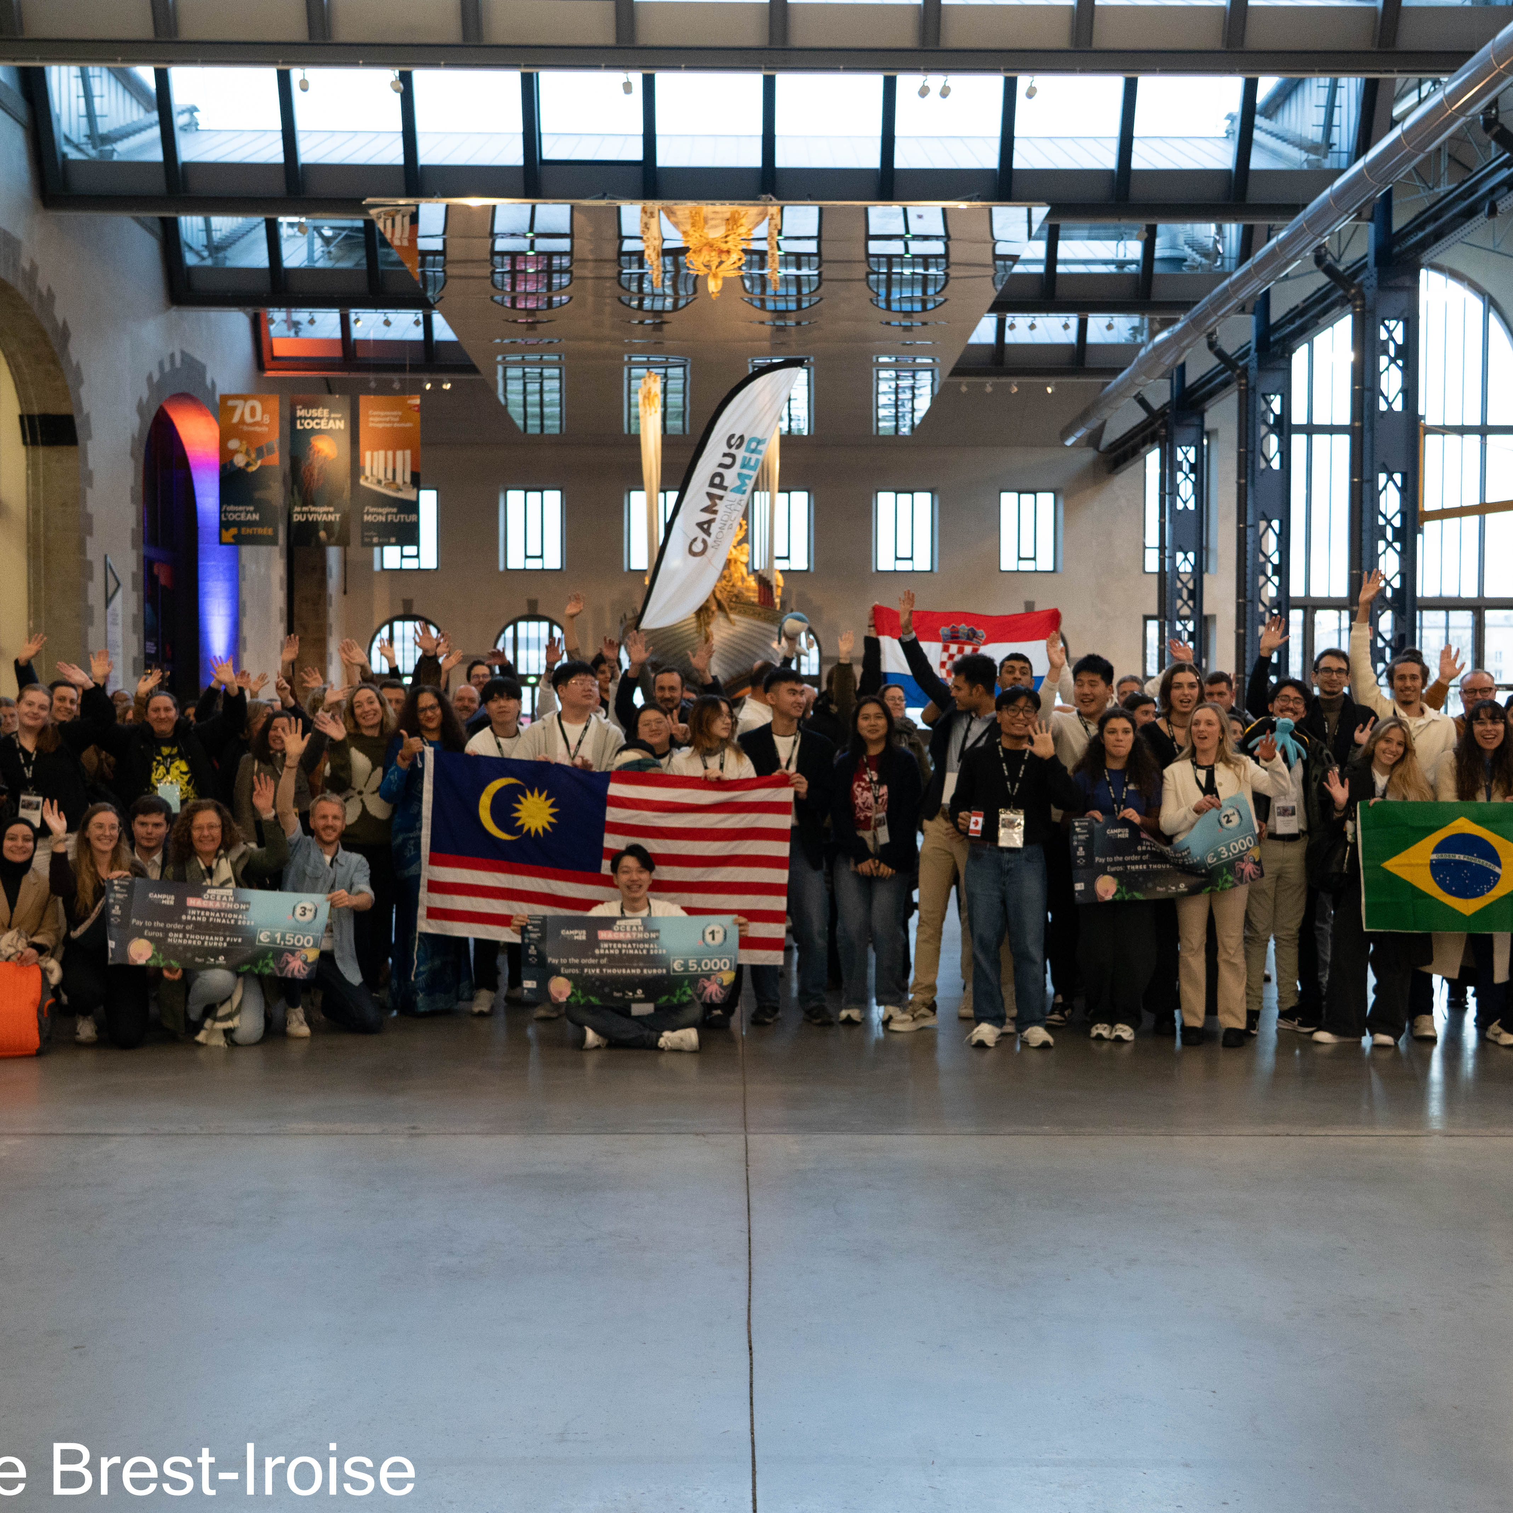
The Ocean Hackathon® concept
Challenges
brought by
challenge owners
16 Oct.
Local events simultaneously in all the cities
18 Oct.
10 Dec.
The Grand Finale
Pitch Contest
Brest, France
Teams
Process:
48hr non-stop
Marine data
coaches
Expected results:
Prototype
Value proposition
Pitch
The winning team of the local event
Notes:
The top team from each location advances to the International Grande Finale in Brest, France.

Slide 19

















Our partners 2026
Ambassadors
Literacy Partner
Data Partners
Notes:
Thanks to :
- Our ambassadors who support the event and will award the three top winners at the Grande Finale.
- Our global data partner can bring data on a large scope since they are either national, european or international. They are public operators. They published reference information and are involved in open science of data access.

Slide 20
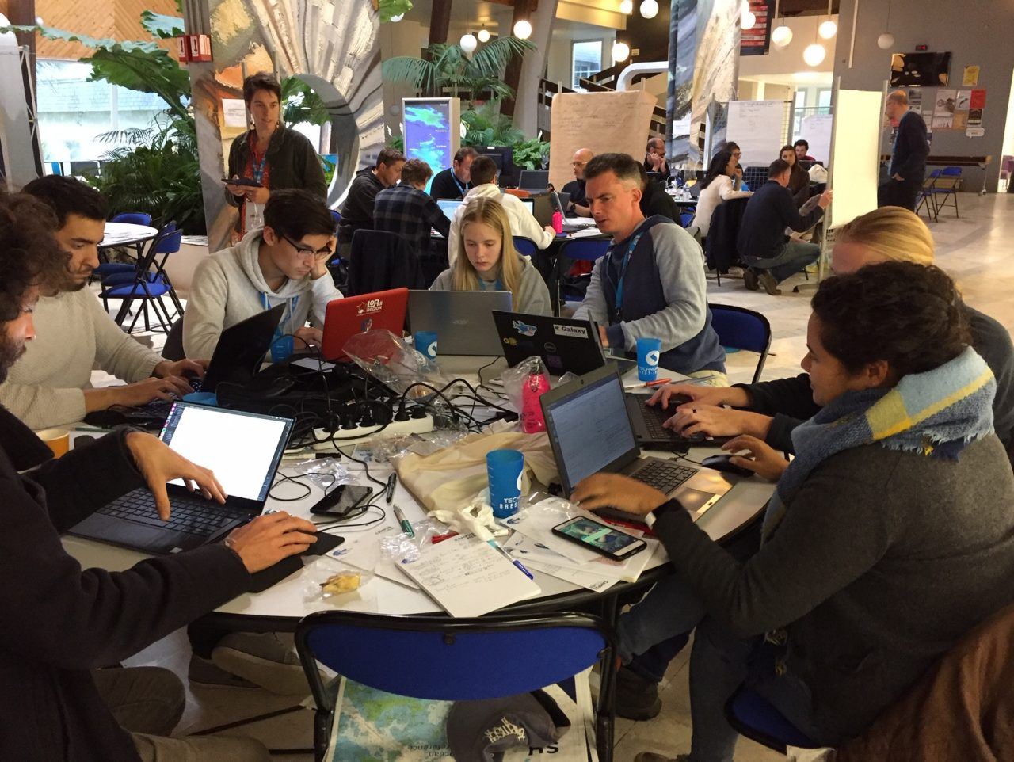
Working as a team, sharing views and experience
YOU WILL :
Tackle your challenge as a team
Live a human experience of collaboration and sharing
Benefit from the experience and skills of each team member!
Take part of an international event and maybe travel to France!

Slide 21
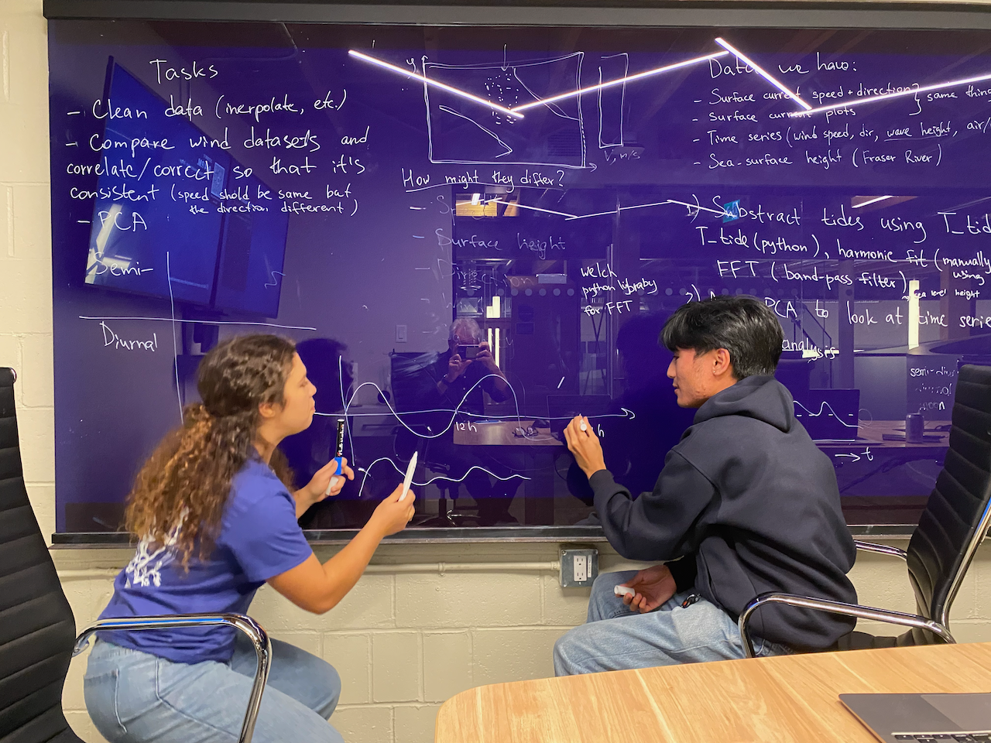
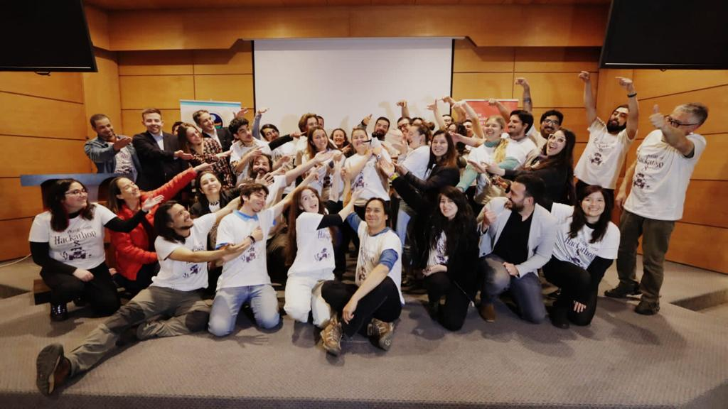
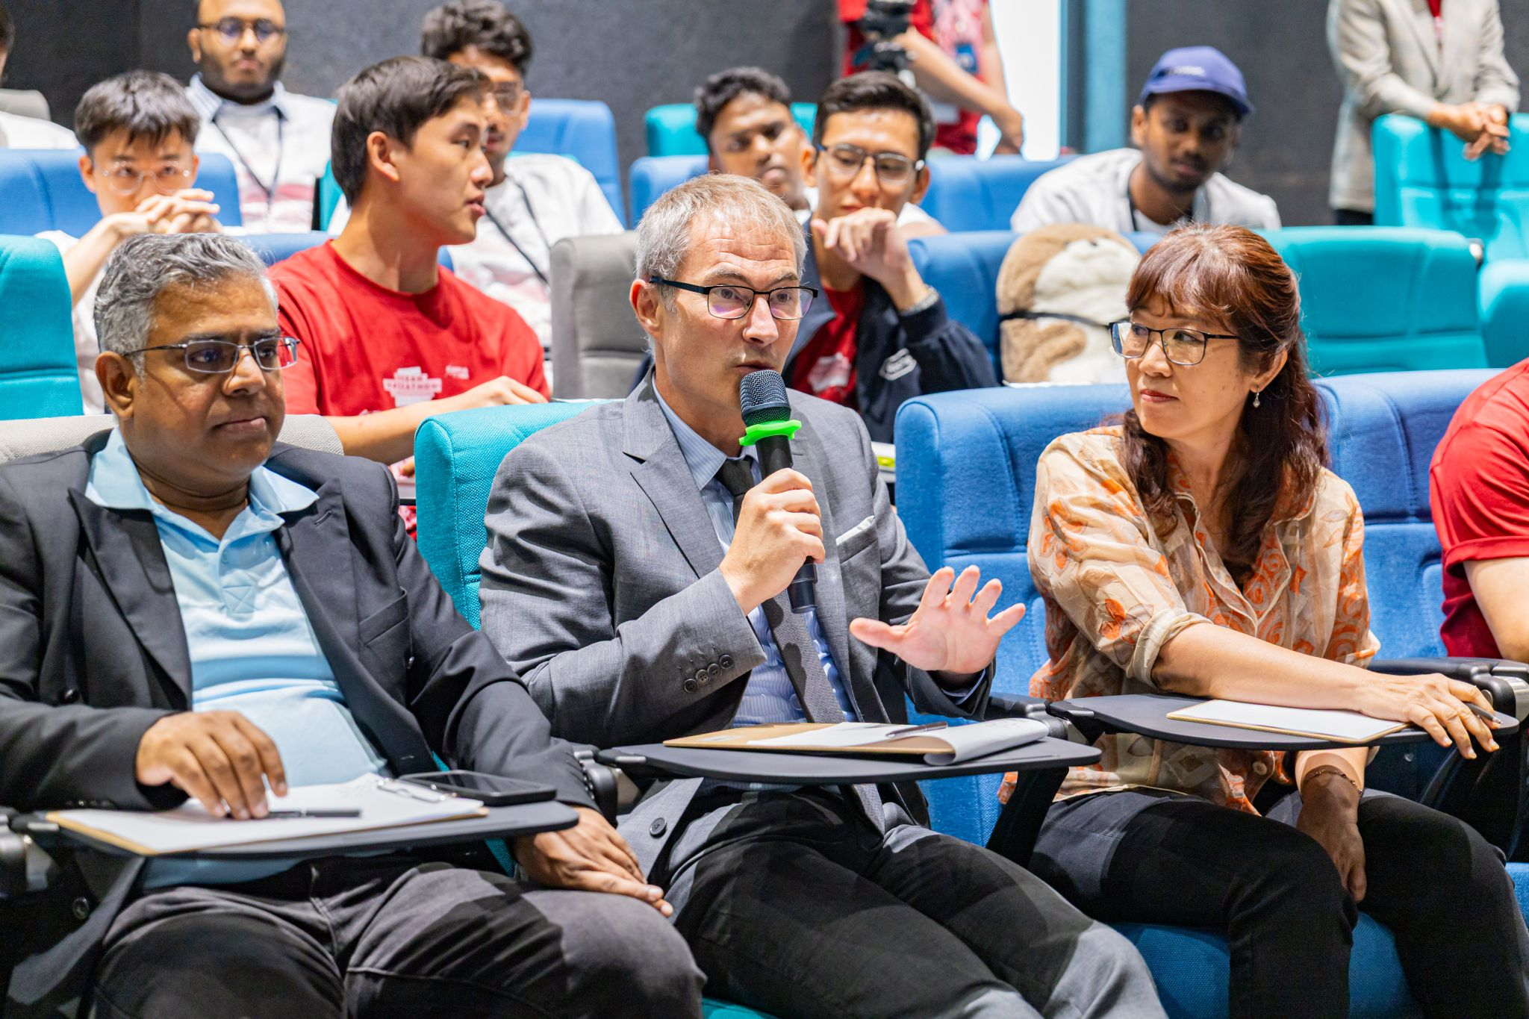
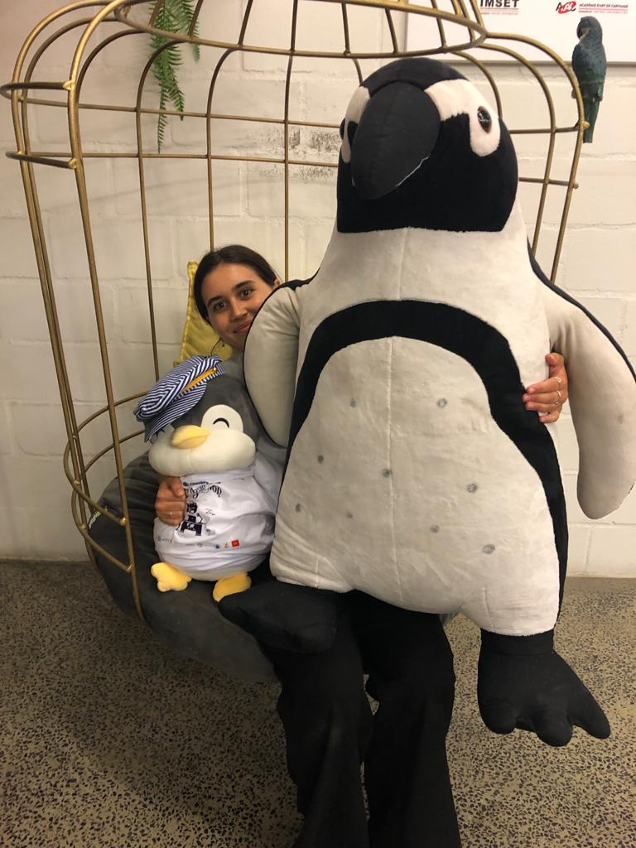
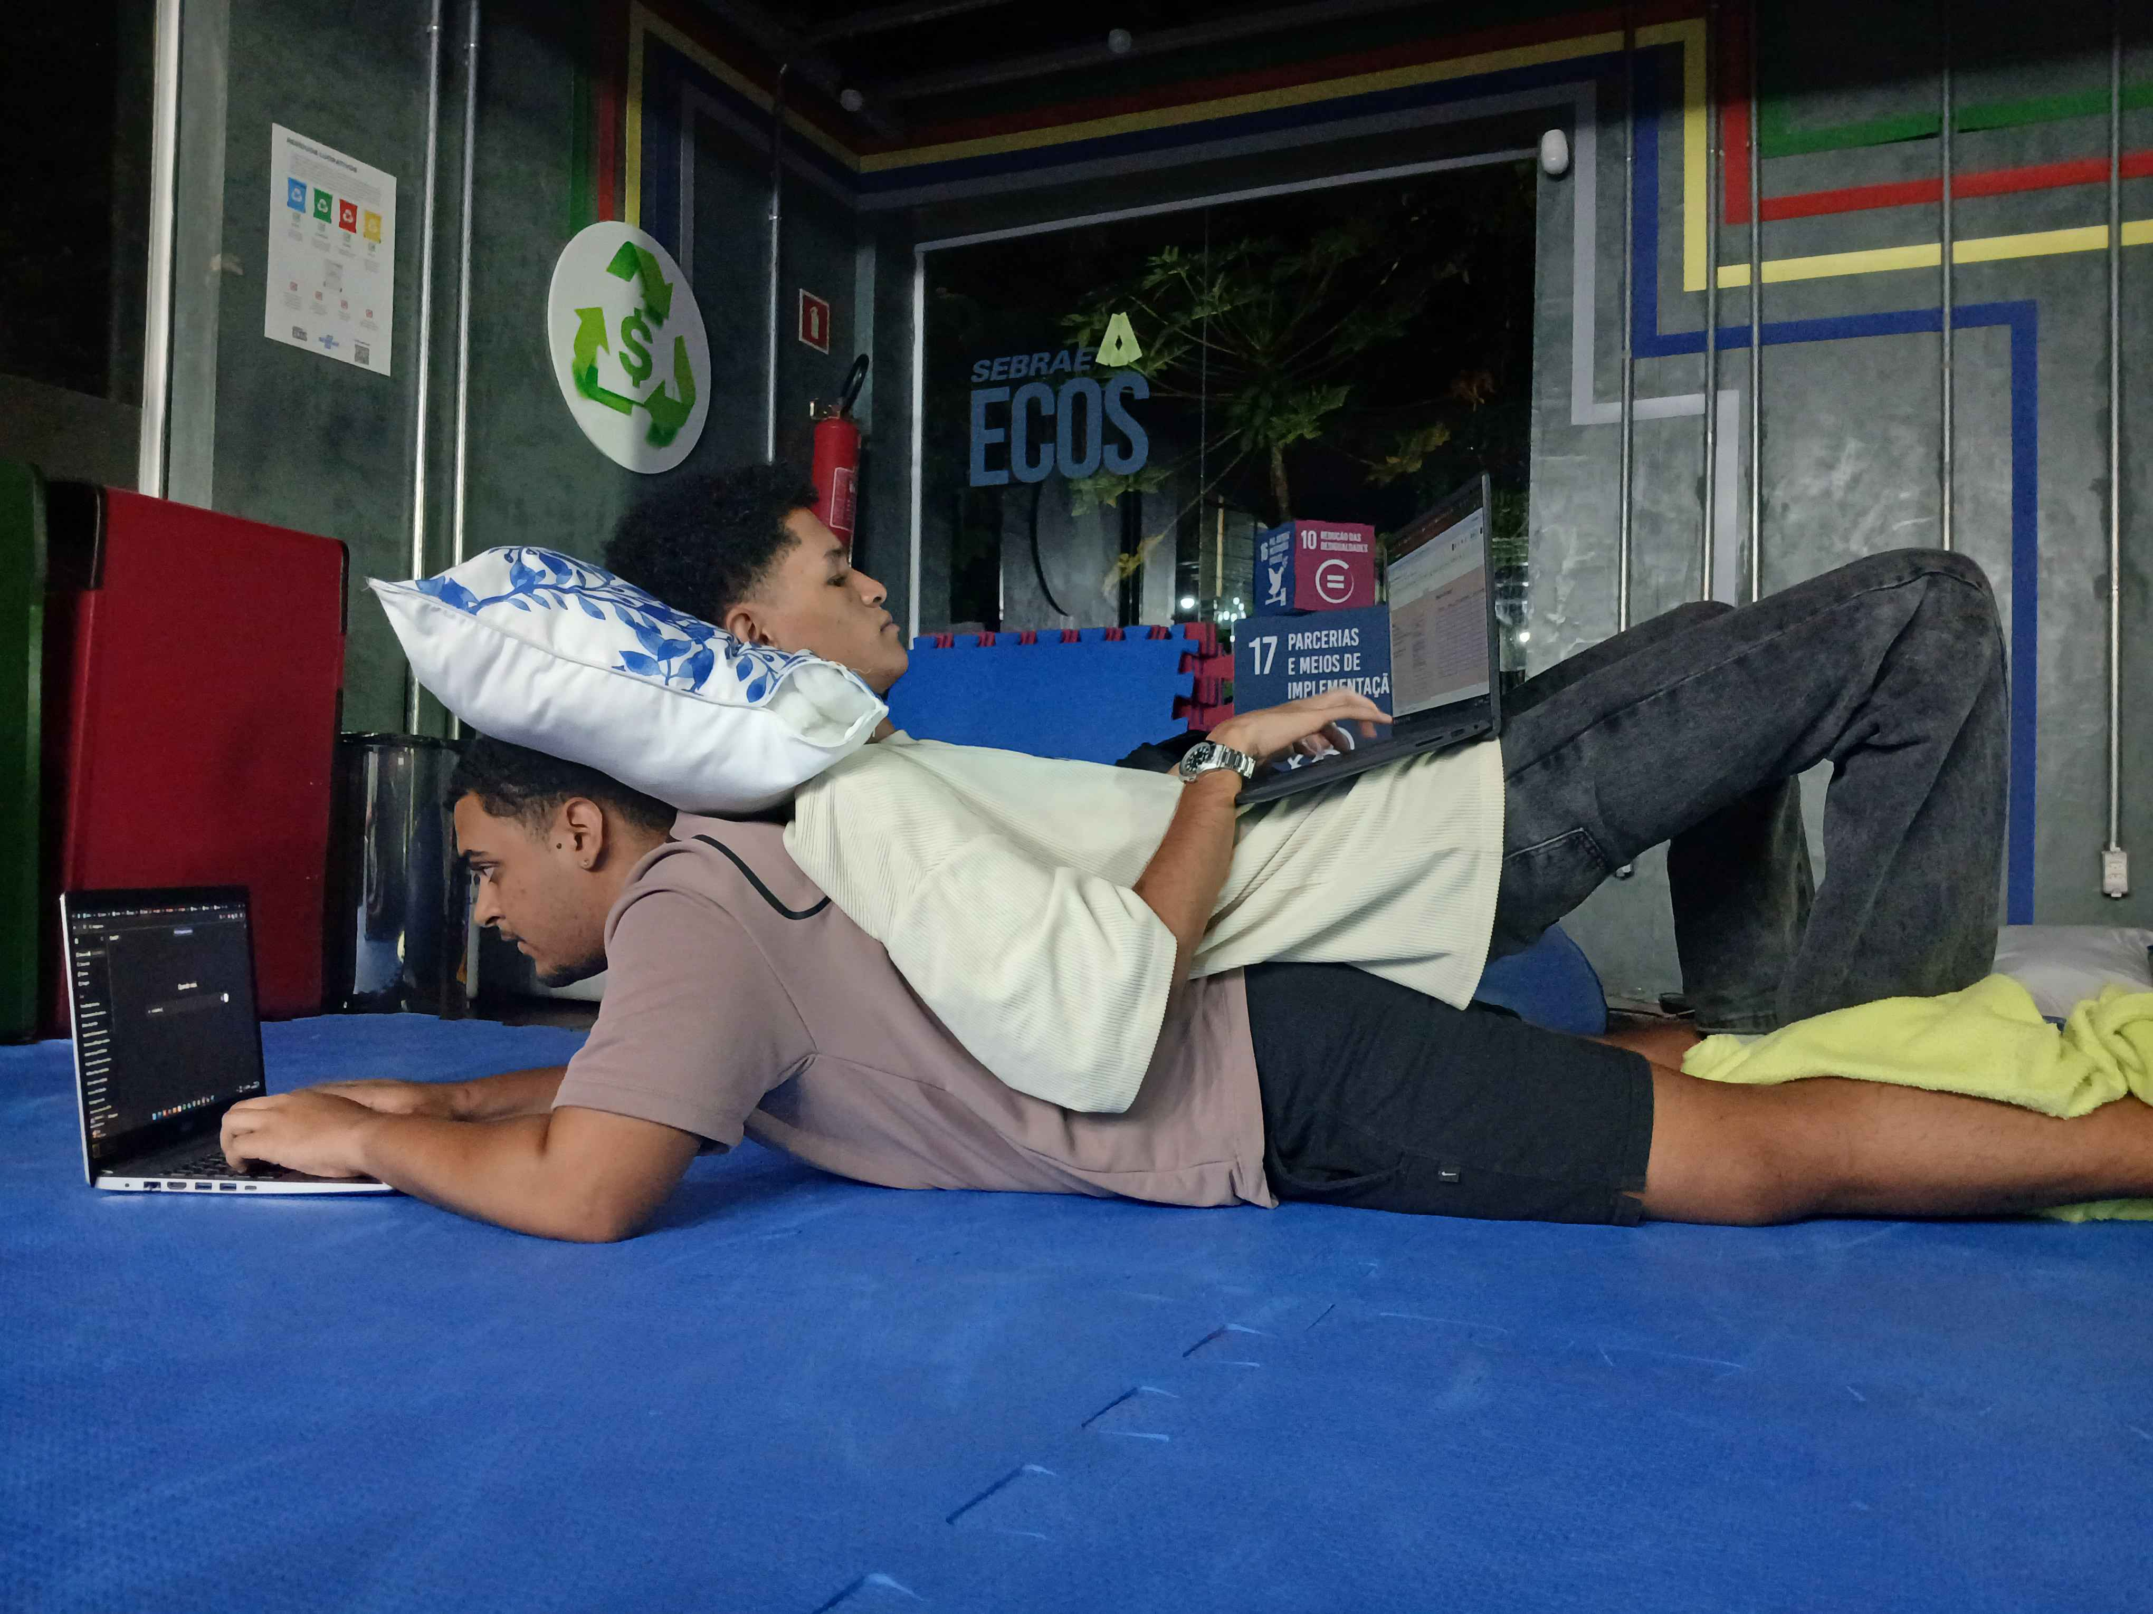
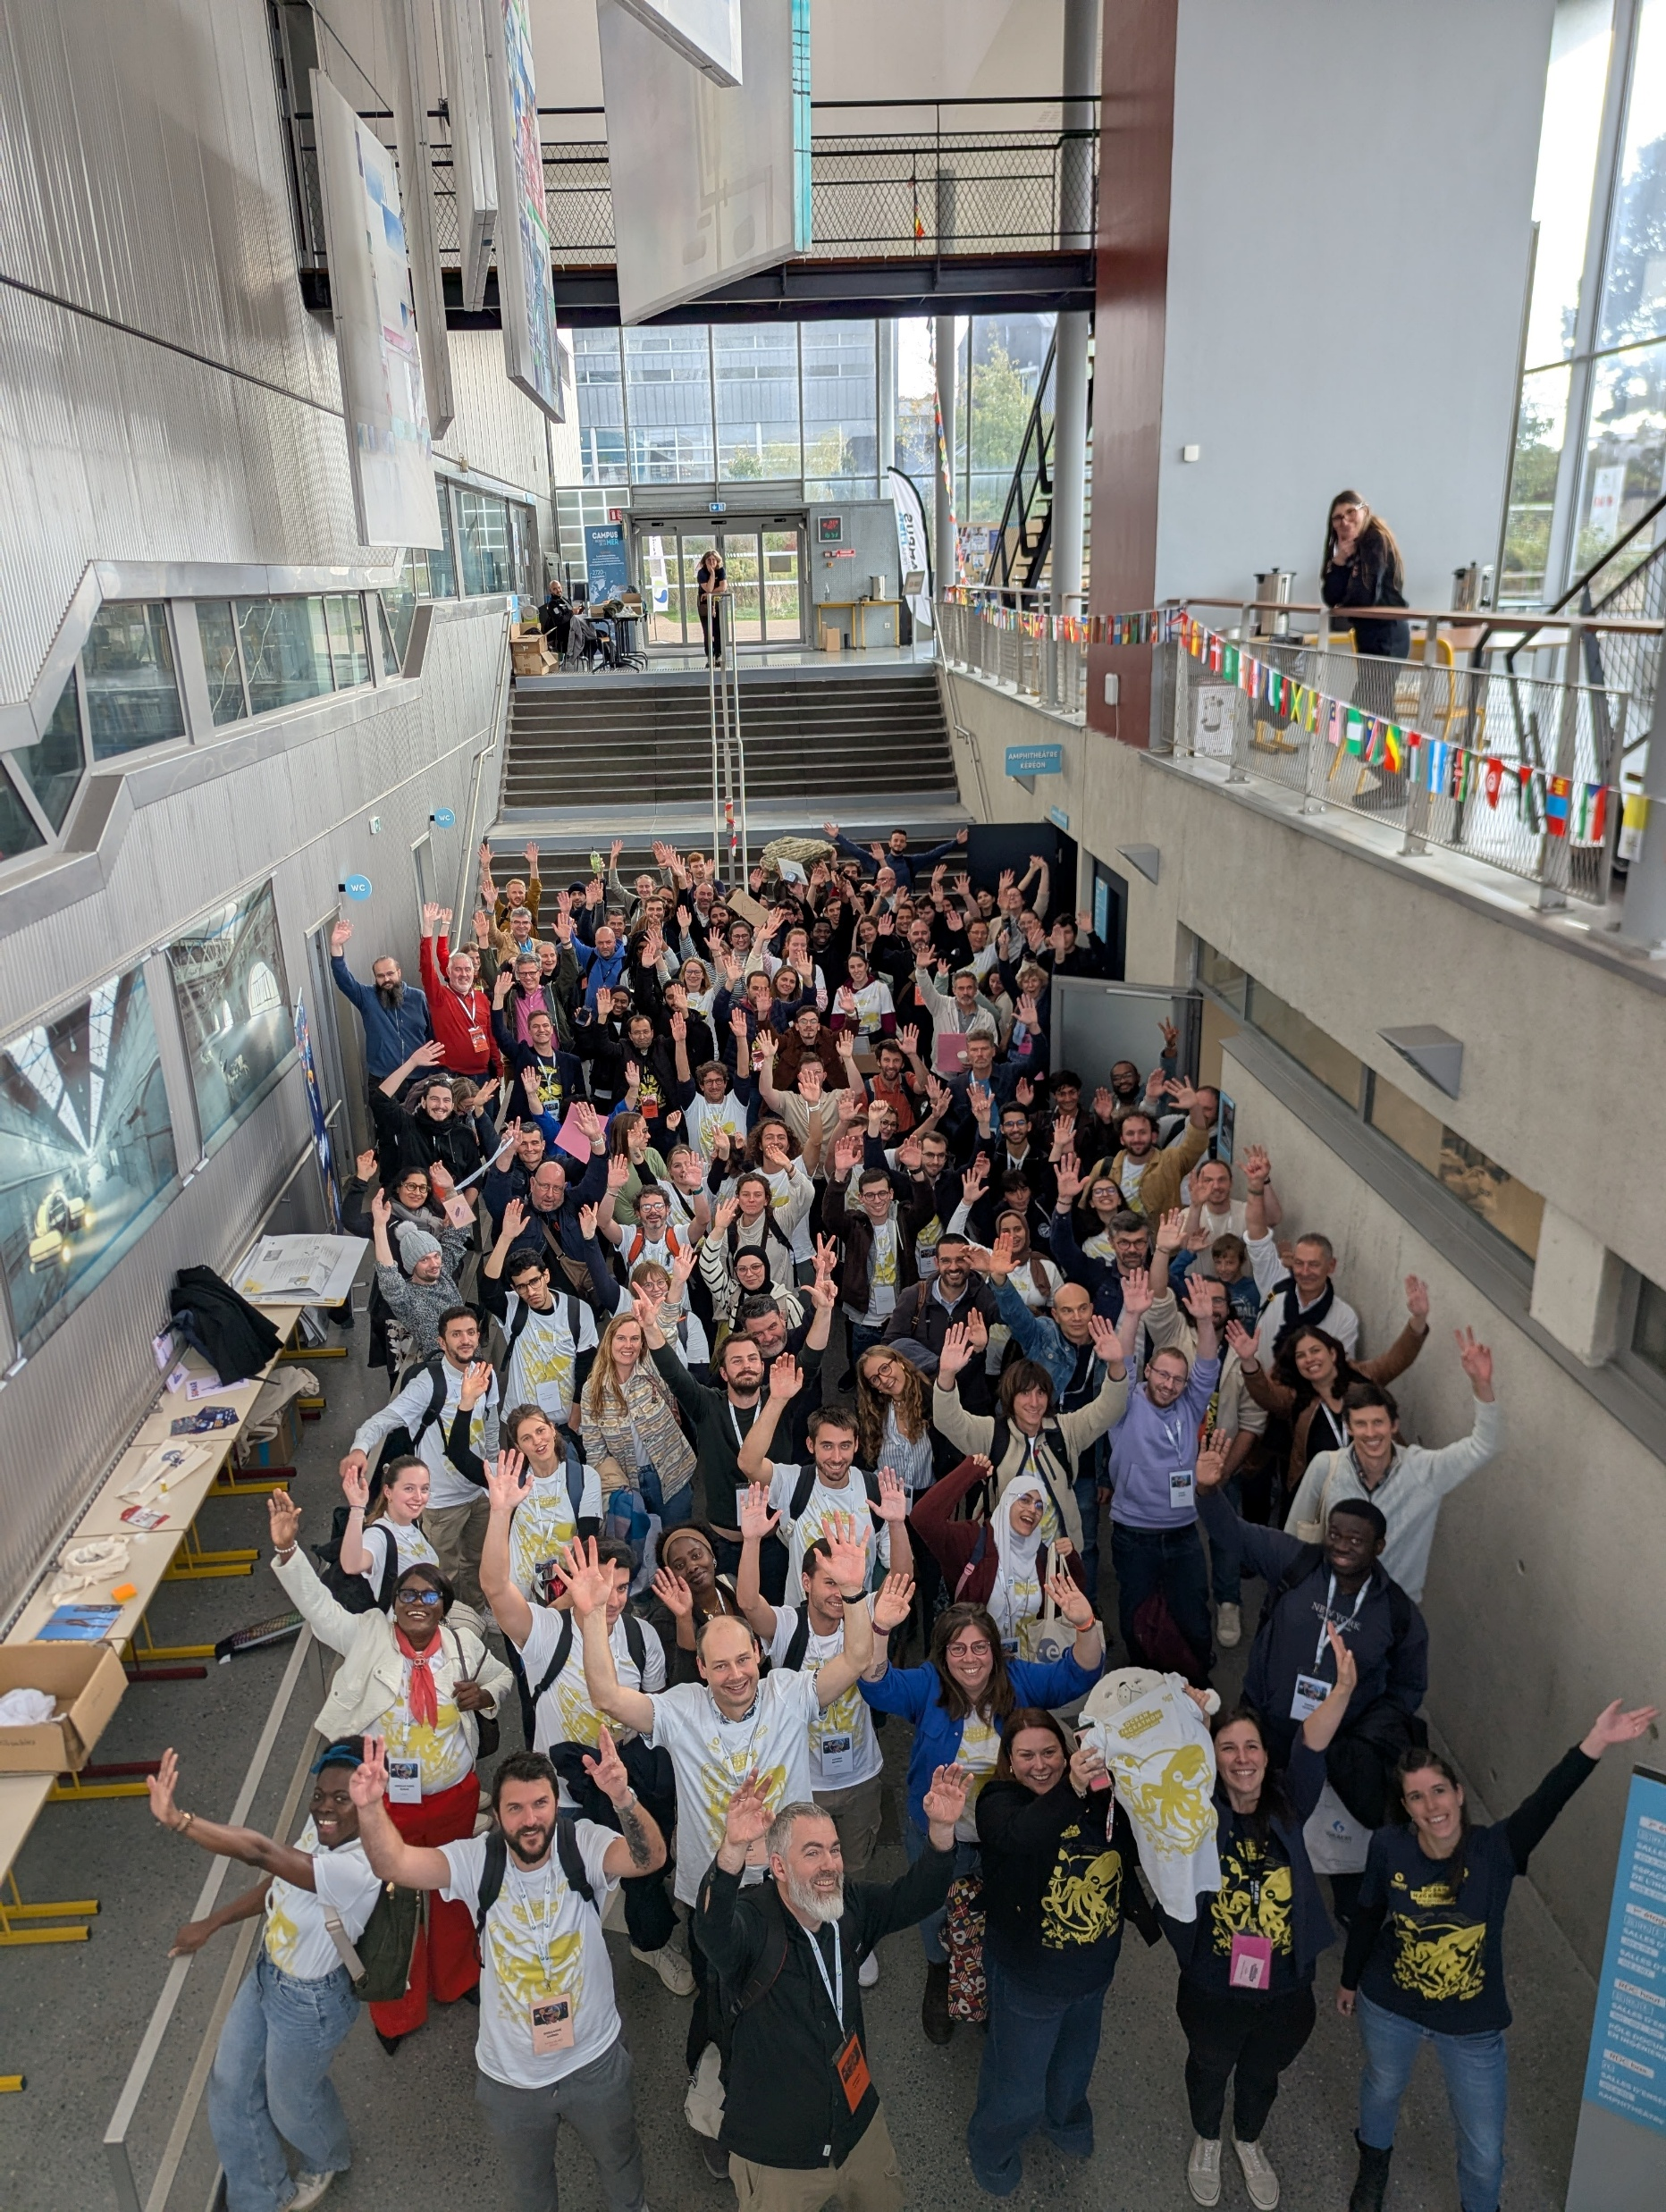
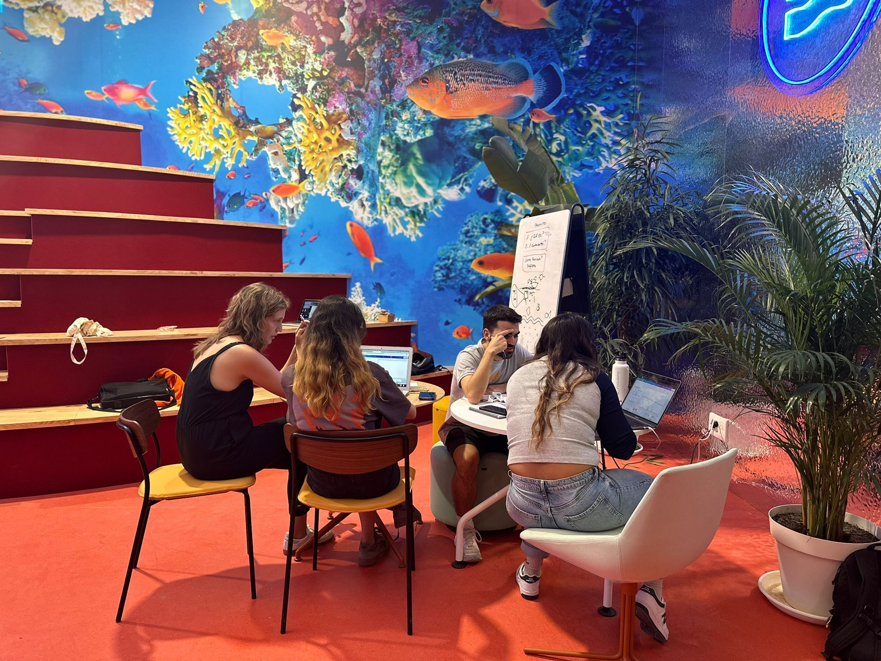
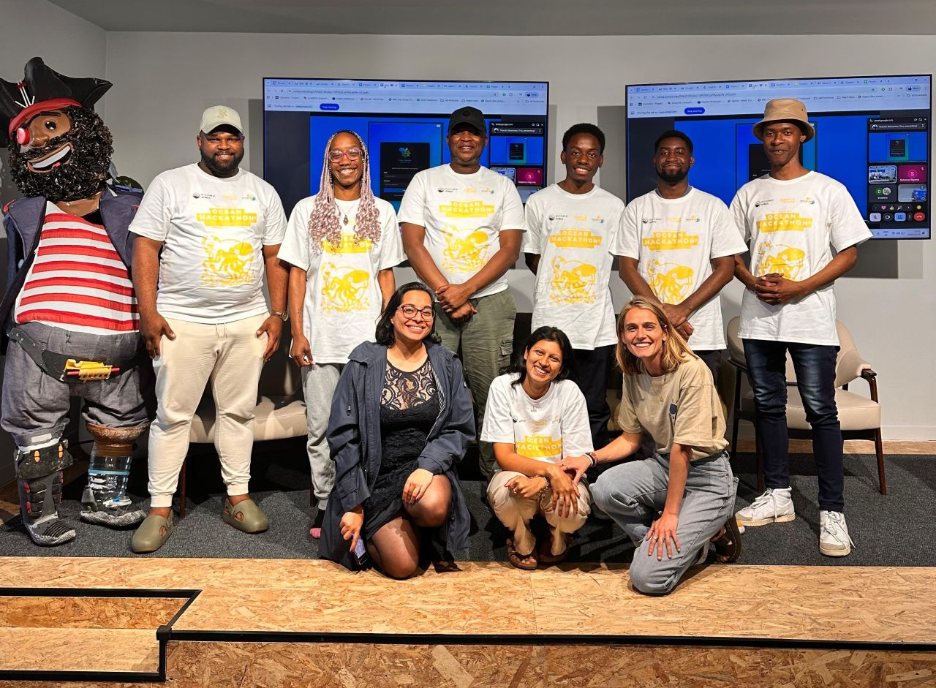
The atmosphere in the 11 cities
Share your story on international Discord server

Slide 22



The atmosphere in the 11 cities
Share your story on international Discord server
Everyone can join it and share pictures
Have a look at the mascot contest pictures and vote!

Slide 23

Intellectual property rights
DATA & TOOLS
Databases and/or tools are protected by intellectual property legislation.
Any use outside the framework of Ocean Hackathon® requires a written agreement in advance between the Participant and the rights holder.
RESULTS / PROTOTYPE
The challenge owner is a legal entity:
the legal entity holds the property rights for the results and their exploitation. Agreement possible between the teammates and the legal entity.
The challenge owner is a private individual:
each teammate hold the rights to exploit the results without the agreement of the others.
Notes:
We ask all the participants to Ocean Hackathon to read and accept the rules before the event during the submission of your challenge and the registration phase.
Key information are available in the rules.
Every participants when they register have to accept and read the rules.
In it there is a section dedicated to intellectual property rights.

Slide 24
What do we expect at the end of the weekend?

Slide 25
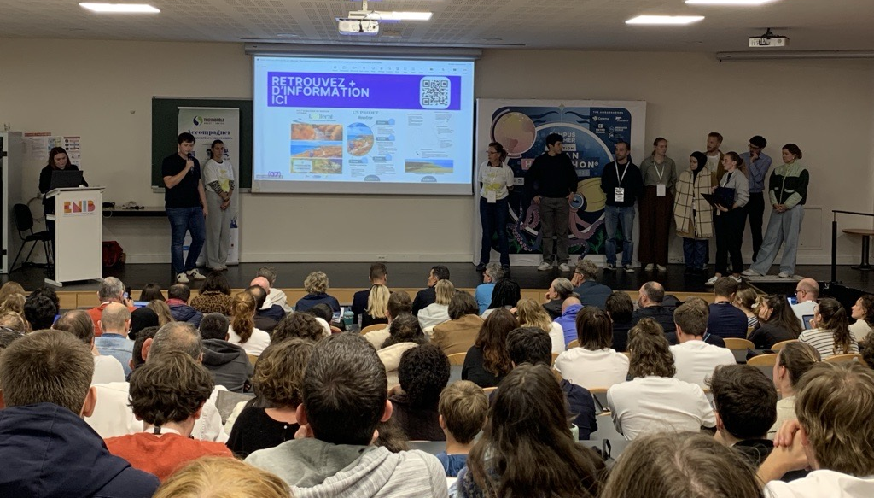
What is excepted at the end of the week-end?
A prototype
that integrates marine and maritime data
Proposition value
of the project
A pitch
lasting a few minutes
+
+
Notes:
You will have to developp a prototype that integrates marine data.
You will have to propose a value proposition regarding your project for example to well identify for which public you developped this prototype and also have a reflexion on the next steps after Ocean Hackathon like potential partners.
A prototype could be an mobile application, a website, a model or a pluggin, a guide build on data. The prototype could be digital or physical.

Slide 26
What is excepted at the end of the week-end?
Scoring
Data at the core of the project – 4 points
Quality and functionality of the prototype – 4 points
Innovative and original nature of the project – 4 points
Potential environmental and societal impact – 4 points
Project ambition – 4 points
Leadership & team – 4 points
Coaches
jury
Quality of the pitch – 10 points
Scored during
the pitch competition
Notes:
The scoring will be the same for all the local editions and all teams:
….will be assess over 4 points on each criteria.
Some of the local coaches will follow-up and evaluate the projects during the week-end.
Then the jury will also assess 10 points during the pitch session.

Slide 27
Explain your project in the Project description file
Your advisers might share
the file with you
Complete the form together
before Sunday noon
Filled by the teams
1 file per team
Notes:
Really important for the following of the project during the event – useful for the coaches
Help to promote the data use for our partners post-event

Slide 28
Support available

Slide 29
The Data catalogue the gateway to the data
Website
www.ocean-hackathon.fr
DATA CATALOGUE
The Data Catalogue contains records for:
Datasets
Data portals
The datasets prepared for your challenge are available in the filter of your city.
Developed on an Ifremer’s
data infrastructure, Sextant
Notes:
The first thing you will have access to will be the data catalogue.
When you submitted your challenges, you gave some informations on your data needs. According to those needs, our data partners are currently working to identify the datasets for your project and to answer to your data request.

Slide 30
The Data catalogue the gateway to the data
Website
www.ocean-hackathon.fr
DATA CATALOGUE
Demonstration video available
on DATA TUTORIALS
The Data Catalogue contains records for:
Datasets
Data portals
The datasets prepared for your challenge are available in the filter of your city.
Developed on an Ifremer’s
data infrastructure, Sextant
Notes:
The first thing you will have access to will be the data catalogue.
When you submitted your challenges, you gave some informations on your data needs. According to those needs, our data partners are currently working to identify the datasets for your project and to answer to your data request.

Slide 31
Online resources
Website
www.ocean-hackathon.fr
RESTRICTED AREA
Same ID for all participants
Username : Participant.user
Login : Hack2026P

Slide 32
Online resources
Website
www.ocean-hackathon.fr
RESTRICTED AREA
Same ID for all participants
Username : Participant.user
Login : Hack2026P
Global data coaches’ booklet
Data catalogue demonstration video
Links to user support
Data partners documents
Links to data portals, viewers
Replay of data tutoring
R-python package
…
Tips for a successful pitch
Time in the participating cities
Notes:
During the event you will have access to ressources on the website available for all the participants. Many ressources will be available to help you in your project.
You will have also access to a restricted area during the event and you will find data tutorials and a toolbox.

Slide 33
Coaches
Project
(IP, business model, etc.)
In your city
Data
(tools, data sets, data processing)
In your city : local coaches
Online : International data coaches on the DATA COACH CENTER
Look at the Global data coaches’ booklet (Data tutorials)

Slide 34
Data coach center
The DATA COACH CENTER
is hosted on a Discord server
Ocean Hackathon® INTERNATIONAL 2026
Thanks to an dedicated Discord server,
you will be able to ask your questions
to the data coaches remotely.
Every participants can have access to the DATA COACH CENTER
→ It can be you or a team mate.
Do not hesitate,
data experts will be available for you
and for the success of your project
Notes:
You will be able to contact data coaches for:
- identifying new datasets
- for help with data processing
- or more general issues

Slide 35


The Global data coaches booklet
Discover the skills and availabilities of our coaches
Booklet available on the
DATA TUTORIALS page
Meet them on THE DATA COACH CENTER

Slide 36
services & tools for the teams
PARTNERS Global + Local
Data
Tutorials
Coaches
DATA TUTORIALS
on-site
and on-line
(DATA COACH CENTER)
Videos
Documents
Links
Tools & services
Data processing, data analysis
Viewers
Teams

Slide 37
Welcome to

Slide 38
Thank you
Merci
Gracias
Obrigado
धन्यवाद krunakara
Terima kasih istuthi

